Slide 1

2025 Contractor Kickoff Webinar
Energy Efficiency Program for Business

Slide 2
Agenda
Safety Moment & Introductions
New for 2025
Applications
Customer Bonuses
Offerings
Portal and OA Demo
Q&A
Survey & Suites
Notes:
Safety Moment & Introductions 8:45 - 8:50
New for 2025 8:50 - 9:10
Applications 9:10 - 9:25
Offerings 9:25 - 9:40
Portal and OA Demo 9:40 - 10:05
Q&A 10:05 - 10:20
Survey & Suites 10:20 - 10:30
Meet the Energy Advisors 10:30 - 11:00

Slide 3


Safety Moment
Working in Summer weather:
1. Wear Appropriate Personal Protective Equipment (PPE)
  • Lightweight, breathable clothing
  • Wide-brimmed hat
  • UV protection sunglasses
2. Stay Hydrated and Take Regular Breaks
  • Drink water frequently
  • Avoid caffeinated or sugary drinks
  • Take breaks in shaded areas
3. Be Aware of Weather Conditions
  • Check weather forecast
  • Schedule tasks during cooler parts of the day
  • Adjust plans for extreme heat
4. Use Sun Protection
  • Apply SPF 30+ sunscreen every 2 hours
  • Use lip balm with SPF
5. Be Cautious of Surroundings
  • Watch for signs of heat exhaustion
  • Be mindful of glare
  • Stay alert for wildlife or insects
Notes:
Katie

Slide 4

Introductions
Wes Maharas
Energy Advisor II
Notes:
Katie

Slide 5
2 4
New for 2025
Notes:
Sara
20 minutes

Slide 6
NEW Concierge Service Model
We are delighted to be your implementor for 2025!
Energy Efficiency Program for Business
Service is our number one priority. We are here to help both you
and the DTE customers, regardless of offering.
Offerings (formerly called programs):
Large Business (LB) formerly called Downstream
Small and Medium Business (SMB)
Midstream (Instant Discounts)
Strategic Energy Management (SEM)
Retro Commissioning (RCx)
Compressed Air and Steam Trap Efficiency formerly called Find & FixTM
Notes:
Jon
5 minutes
Talk through the concierge model beyond what’s on the slide
Large Business – custom, prescriptive and non-prescriptive

Slide 7
NEW Program Contact Info
Program Phone Number: 855.748.2525
Customers
Website dteenergy.com/business
Email
saveenergy@dteenergy.com
Contractors
Website
www.michiganee.com
Email contractors@michiganee.com
Notes:
Sara
One point of contact for customers. Contractors can also reach out to this number if they don't have an assigned energy advisor.
2 minutes

Slide 8
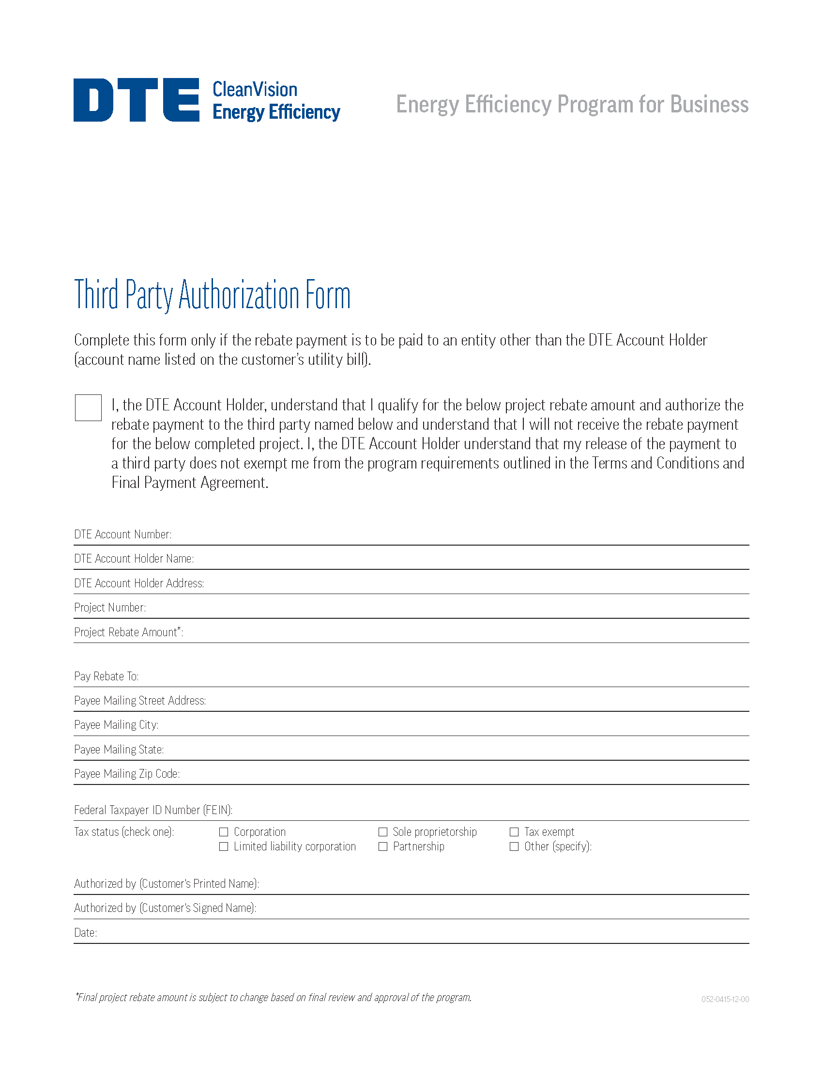

NEW Program Materials
Updated and new program materials being created:
Policies & Procedures
Third party agreement
Program overview flyer
Bonus flyers
Case studies
FAQs
And more!
View Sales Tools
Notes:
Sara
5 minutes
New program materials are being created and will be posted on the contractor microsite and provided to you

Slide 9
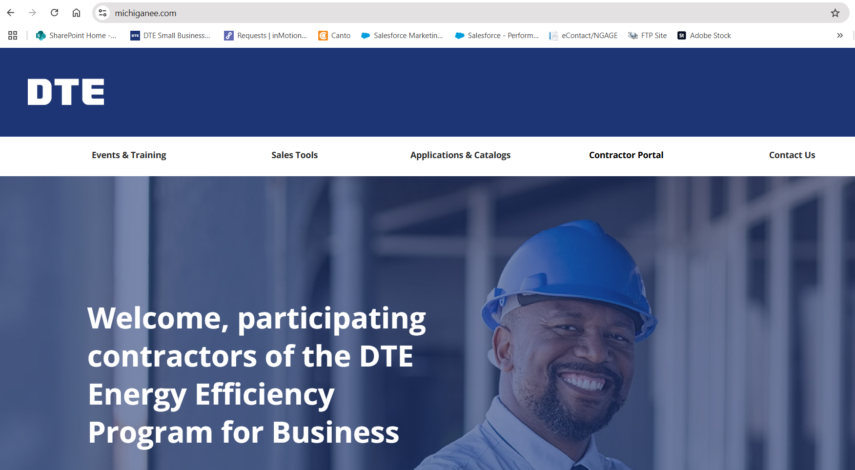
NEW Contractor Microsite
New website designed for all contractors supporting the DTE Energy Efficiency for Business offerings!
www.michiganee.com
Notes:
Katie
5 minutes

Slide 10
2 4
Applications
Notes:
Sara
15 minutes

Slide 11


Catalogs, Applications & Rebates
Large Business:
NEW online application (OA) with pdf catalog
No longer utilizing a joint application with Consumers
Small & Medium Business:
Online or fillable pdf application with pdf catalog
Notes:
Sara
5 minutes
No changes to Small and Medium Application

Slide 12
Application Processing
Reservation Application
Application Review
7-14
90
7-14
2-4
Reservation Letter Issued
days
days
days
weeks
Install Measures
Pre-application
processing
Application funds reserved
Final application
processing
Rebate received
Final Application & Review
Payment
Notes:
Sara
3 minutes
Cynthia wants to make sure we are covering ACH payments thoroughly
Process: separate from application process. Melissa Grace to RO to Robert to provide process.
For contractors, it will be the same process. Reach out to those that want to be signed up – receive an announcement/sign-up email – send out recruitment email – they'll click on email and go into to sign up for ACH.
Will need a new w-9/banking information to set up.
Also explain third party payment process

Slide 13
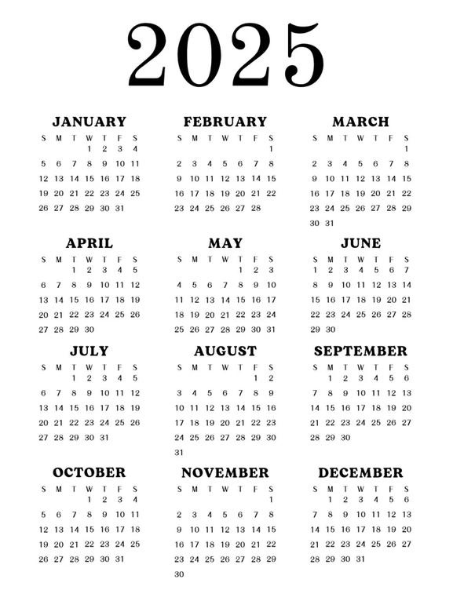
Application Deadline
The Program Year ends Dec. 1
  No Reservations will be extended beyond Dec. 1
  Final Applications must be submitted within 60 days of project completion date or Dec. 1, whichever comes first
  Incomplete Final Applications may be subject to cancellation
  Any Application submitted after Dec. 1 may be cancelled
1
Notes:
Sara
5 minutes
Monday, December 1

Slide 14
2025 Rebate and Measure Updates
Large Business
Process boiler tune-up at $0.20 per mbh
Custom rebates will remain the same at $0.08 kwh capped at 50%
Small and Medium Business
Window film at $17 per 100 sq. ft of glazing
Original double hung window with low U storm at $118 per 100 sq. ft of glazing
Process boiler and process burner tune-up (rebate amounts vary/type)
Large high efficiency gas water heater at $125 per heater
Heat curtains for greenhouses at $0.05 per sq ft
Greenhouse infrared film at $0.05 per sq ft
Notes:
Sara
5 minutes
No changes to Small and Medium Application

Slide 15
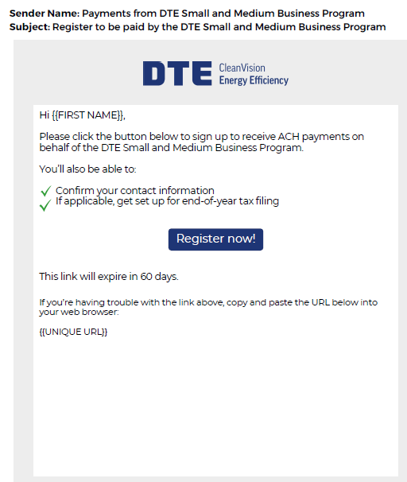
ACH Payments with Choice Digital
Continuing for SMB
Enroll in ACH to receive bonus or rebate payments
Receive invite email from vendor
Complete the Registration Process
Provide W9 and banking information
ACH Will also be available for customers
Notes:
Jon
3 minutes
Cynthia wants to make sure we are covering ACH payments thoroughly
Process: separate from application process. Melissa Grace to RO to Robert to provide process.
For contractors, it will be the same process. Reach out to those that want to be signed up – receive an announcement/sign-up email – send out recruitment email – they'll click on email and go into to sign up for ACH.
Will need a new w-9/banking information to set up.
Also explain third party payment process
When do they receive ACH invitation email

Slide 16
2 4
Program Offerings
Notes:
Rotation
15 minutes

Slide 17
2 4
Large Business
“LB”
Notes:
Jon

Slide 18
2025 LB Bonus Structure
Customer
Electric Only | 20% Early Completion Bonus | Ends 9/30/25
Gas Only | 20% Early Completion Bonus | Ends 12/1/25
Long Life Measures (Electric/Gas) | 20% Additional Bonus | Ends 12/1/25
Contractor
Electric Only | 20% Early Completion Bonus (PC only) | Ends 9/30/25
Gas Only | 20% Early Completion Bonus (PC only) | Ends 12/1/25
Electric/Gas | New Project Bonus (All) | Ends 6/30/25
Electric/Gas | Contractor Performance Agreements (PC only) | Ends 12/1/25
We are excited to announce that the deadline for the gas bonus has been extended through December 1, 2025! Please note, starting July 1, 2025 maintenance measures like boiler tune-ups and steam traps will no longer be eligible for the gas bonus.
*Additional 20% bonus includes select long-life measures and custom projects. Work with your Energy Advisor to identify eligibility.
All bonuses can be combined. Bonuses are subject to change.
Notes:
Jon
Speak to requirements of this bonus

Slide 19
LB Participating Contractors
2024 Contractor status will carry over into 2025
Must complete training
    Virtual training or individual EA training available
    When training is complete, a form will be sent via email
    Submit completed form and W9
    Attending this event counts as training
Eligible for third party payment
Eligible to receive contractor bonuses
Look out for an email with your participating contractor form available for download. Please sign it and send back to contractors@michiganee.com once completed
Notes:
Jon

Slide 20
Rebate Process – Key Reminders
Digital Signature Required
Customer must sign via Conga to confirm rebate amount and payee info.
Conga Email Details
Know the email format and domain to help customers identify it.
Legitimacy Concerns
Customers can:
  Reply to the Conga email
  Contact the rep listed in the email
  Use general program contact info
  *Please see example of the email from Conga you should receive on the next slide.
Notes:
Jon

Slide 21
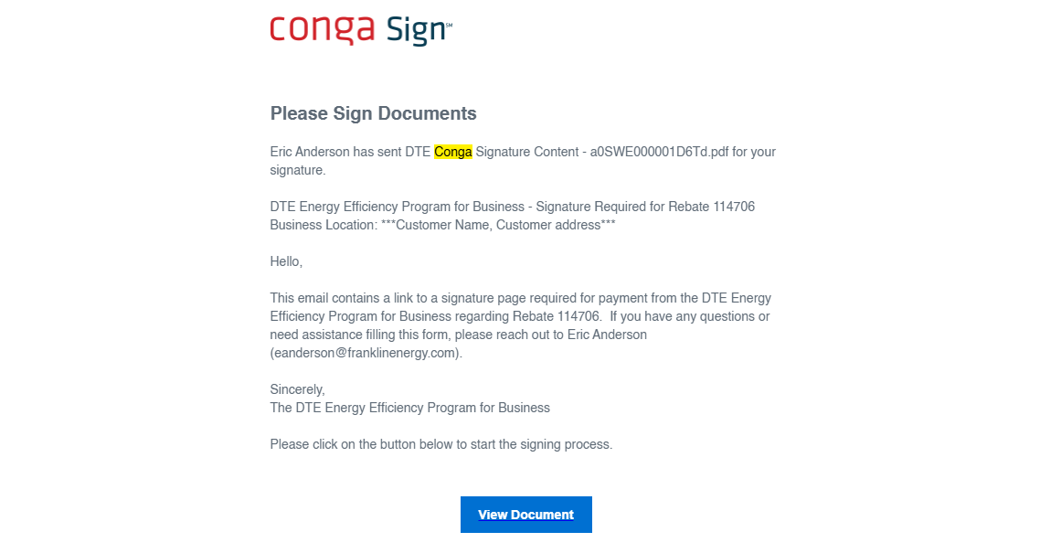
Rebate Process – Key Reminders
Notes:
Jon

Slide 22
2 4
Small and Medium Business
“SMB”
Notes:
Melissa/Mike
Be prepared to answer this question:
Which program should I work with? Continue working with the customers/program you've been working with.

Slide 23
2025 SMB Bonus Structure
60% Interior Lighting
40% Exterior Lighting
20% Refrigeration
100% Gas Bonus
Excludes downlights, exit signs, occupancy sensors, custom lighting, and case door lighting
Includes all exterior lighting upgrades except downlights and custom lighting
All refrigeration measures, including
case door lighting
All gas measures, including
furnace/boiler replacements & tune-ups and infrared heaters
All bonuses above end December 1, 2025
*All bonuses are subject to change
Notes:
Melissa/Mike
Emphasize all bonuses are subject to change

Slide 24
2 4
Midstream
“Instant Discounts”
Notes:
Mike – GR/Mark - Troy

Slide 25
Distributor Process
Step 1:
Customer interested
in product
Step 2:
Distributor confirms
eligible product
Step 3:
Distributor confirms
installation address eligible
Step 4:
Distributor offers discount at
the point of sale* to the customer
Step 5:
Distributor submits invoice to
DTE for reimbursement
*some projects require pre-approval
Notes:
Mike – GR/Mark - Troy
Process is still the same. All online in the tool.

Slide 26
NEW for 2025
Lighting
Food Service
HVAC
  Dual Sensor controls incentive
  Occ and Dual Sensor incentives for LED Flat/Panels/Troffers
  Radiant Conveyor
  Refrigerated Chef Base
  Small incentive reductions for VRF and PTHP
Notes:
Mike – GR/Mark - Troy
New for Midstream
We'll follow-up with the contact information via email after the event

Slide 27
2 4
Compressed Air and Steam Trap Efficiency
Notes:
Jon

Slide 28
Compressed Air/Steam Overview
New for 2025
Contractor-driven program
We partner with you to drive savings
EAs identify lead opportunities
Opportunities to increase your business
Can be customer or contractor repaired
Compressed Air Nozzles
Provide Free Fixed or Handheld Air Nozzles to customers
Notes:
Jon

Slide 29
2 4
Strategic Energy Management
“SEM”
Notes:
Dash

Slide 30
SEM Overview
Customer-driven offering with long-term relationship (12-24 month coaching) focused on continuous improvement of energy performance
Benefits for contractors:
Identifying capital projects
Proactive approach to supporting customers on prescriptive and non-prescriptive measures, creating project opportunities
Notes:
Dash

Slide 31
2 4
Retro Commissioning
“RCx”
Notes:
Dash

Slide 32
RCx Overview
Customer-driven, multi-track version of SEM with less time and commitment required from the customer.
Benefits for contractors:
    Contact us for tune-up process and control work
Proactive approach to supporting customers on prescriptive and non-prescriptive measures, creating project opportunities
    Customers tend to reinvest into the program for additional energy-efficiency opportunities
Notes:
Dash

Slide 33
2 4
MISaves
Notes:
Todd

Slide 34
Michigan Saves
DTE Energy
Todd O’Grady
248-701-3058
togrady@michigansaves.org

Slide 35
Commercial and Public Sector
Energy Financing
Interest rates as low as 0% APR
Michigan Saves is pleased to partner with DTE Energy to offer:
  Special financing as low as 0% APR with terms up to 36 months for projects up to $250,000
  Quick, hassle-free credit approval
  Financing for custom and prescriptive gas and electric projects, including energy efficient lighting, refrigeration, heating and cooling equipment, and more
  DTE is covering the contractor fee until further notice
*For DTE Energy customers only. Interest rate buydown amount cannot exceed the total amount of the rebate incentives.
Contact: Todd O'Grady
248-701-3058
togrady@michigansaves.org
MichiganSaves.org

Slide 36
Thank You & What’s Ahead…
Additional Program Materials
Quarterly Newsletters
Contractor Council
Sales Training & Support Opportunities
Contractor Golf Event
Mid-Year Check-in Event
Participating Contractor Trainings (LB only)
And more!
You will be updated as new offerings roll out
Have anything you’d like to see? Put it in the survey!
Notes:
Sara

Slide 37
Portal and OA benefits
Provides customers and contractors a convenient way to submit and monitor applications for rebates
Provides real-time status information on applications
Provides better online information including application processing requirements
Rollover projects will automatically be entered into the portal
Portal & OA Demo
Notes:
Mike
25 minutes
Login:
DTE.SB.Demo@gmail.com
DTEtest2023!
Account number: 920045538492
Zip Code: 48226
You can use this DTE dummy account. It is an electric account so you will need to enter it in the electric account field and put N/A in gas and just explain that they put in the correct account number based on what measures they are trying to apply for.
https://tradeally.efficiencynavigator.com/Account/Login

Slide 38
2 4
Q&A
Notes:
Sara MCs, Full team answers
20 minutes

Slide 39
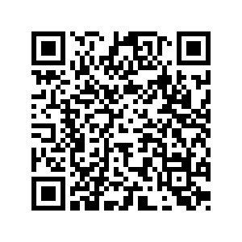
We want to hear from you.
Take the
Survey!
Scan >
or
Click >
https://survey.alchemer.com/s3/8250747/DTE-C-I-2025-Participating-Contractor-Training-Survey
Notes:
Sara

Slide 40



And the winners are…
2 4
Notes:
Sara and Katie/Brie
Select random winners – hand winner card to Sara prior to the announcement

Slide 41
Thank you!
Contact Us
Phone: 855.748.2525
Email: contractors@michiganee.com
Website: www.michiganee.com
Notes:
Will include prescriptive, non-prescriptive, RCx, SEM, Find and Fix, Custom?…..

